Slide 1
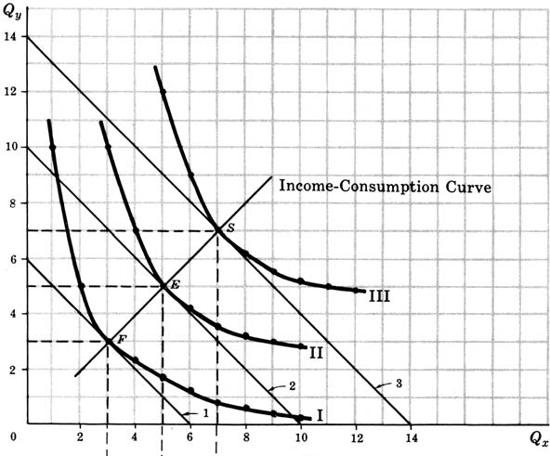
INCOME EFFECT : INCOME CONSUMPTION CURVE
The income effect means the change in consumer’s purchases of the goods as a result of a change in his money income.
Income consumption curve traces out the income effect on the quantity consumed of the goods. Income effect can either be positive or negative. Income effect for a good is said to be positive when with the increase in income of the consumer, his consumption of the good

Slide 2
Cases
Income effect for a good is said to be negative when with the increases in his income, the consumer reduces his consumption of the good. Such goods for which income effect is negative are called Inferior Goods
Income effect for a good is said to be positive when with the increase in income of the consumer, his consumption of the good also increases. This is the normal case
a) Good Y is inferior and Good X is Normal
b) Good Y is inferior and Good X is Normal
ICC Q5
Q4
IC5
IC4
Q3
Q IC3
2
Q1 IC2 IC1

Slide 3
See Book
Page 172, 173, 174

Slide 4
Elasticity of Demand
Learning Outcome
Understanding concept of Elasticity
Measurement and Types of elasticity
Application of concept of elasticity

Slide 5
Concept and Definition
The concept of elasticity has a very great importance in economic theory as well as for formulation of suitable economic policies.
The law of demand indicates only the direction of change in quantity demanded in response to a change in price. This does not tell us by how much or to what extent the quantity demanded of a good will change in response to a change in its price. This information as to how much or to what extent the quantity demanded of a good will change as a result of a change in its price is provided by the concept of elasticity of demand.
The concept of elasticity of demand therefore refers to the degree of responsiveness of quantity demanded of a good to a change in its price, consumers’ income and prices of related goods.
Accordingly, there are three concepts of demand elasticity :
Price elasticity,
Income elasticity, and
Cross elasticity

Slide 6
PRICE ELASTICITY OF DEMAND
Price elasticity of demand is defined as the ratio of the percentage change in quantity demanded of a commodity to a percentage change in price. Thus
Formula :
Demand is said to be elastic if e >1, inelastic if e < 1, and unitary elastic if e =1.
The main reason for differences in elasticity of demand is the possibility of substitution i.e., the presence or absence of competing substitutes. The greater the ease with which substitutes can be found for a commodity or with which it can be substituted for other commodities, the greater will be the price elasticity of demand of that commodity.

Slide 7
Perfectly Inelastic and Perfectly Elastic Demand First extreme situation is of perfectly inelastic demand curve is a vertical straight line (ep = 0) The second extreme situation is of perfectly elastic demand in which case demand curve is a horizontal straight line (ep = Infinity )
Price
D
ep = ∞
P
D
ep = 0
O

Slide 8
Elastic Demand and Inelastic Demand
Y Y
Demand for a good is said to be elastic if price elasticity of demand for it is greater than one. Similarly, the demand for a good is called inelastic if price elasticity of demand for it is less than one
The terms elastic and inelastic demand are used in the relative sense. In other words, elasticity is a matter of degree only.
D
D
D
D

Slide 9
Condition 1
When demand is elastic (e_{p} >1).
When demand for a commodity is elastic (e_{p} > 1), the percentage increase in quantity demanded of the commodity will be greater than the percentage fall in price that caused the former. As a result, total revenue will increase following the reduction in price of the commodity. Conversely, this also implies that when demand is elastic (e_{p} >1), rise in price will cause the total revenue to decrease.
When demand for good is elastic (e_{p} >1), a fall in price raises total revenue and a rise in price reduces total revenue.

Slide 10
Condition 2
When Demand is Inelastic (e_{p,} <1)
When demand for a commodity is inelastic, with a fall in price the quantity demanded of a good increases proportionately less then the fall in price. Therefore, in this case of inelastic demand, with a fall in price, total revenue (or expenditure) decreases. This also implies that when demand is inelastic, the rise in price will lead to a percentage decline in quantity demanded that is proportionately less than the rise in price. As a result, if demand is inelastic, rise in price will cause total revenue to increase
When demand for a good is inelastic (e_{p} <1) , a fall in price reduces total revenue and a rise in price raises total revenue.

Slide 11
Condition 3
When demand is unit-elastic (e_{p} = 1).
When the demand for a commodity is unit-elastic, with the fall or rise in price, the quantity demanded rises or falls in the same proportion as the change in price . As a result, in case of unit-elastic demand, total revenue (P×Q) remains the same when price changes.
When demand for a commodity is unit-elastic (e_{p} =1), changes in its price do not affect total revenue.

Slide 12
Problem
Suppose a seller of a textile cloth wants to lower the price of its cloth from Rs. 150 per metre to Rs. 142.5 per metre. If its present sales are 2000 metres per month and further it is estimated that its elasticity of demand for the product equals – 0.7. Show
Whether or not his total revenue will increase as a result of his decision to lower the price; and
Calculate the exact magnitude of its new total revenue.

